Slide 1

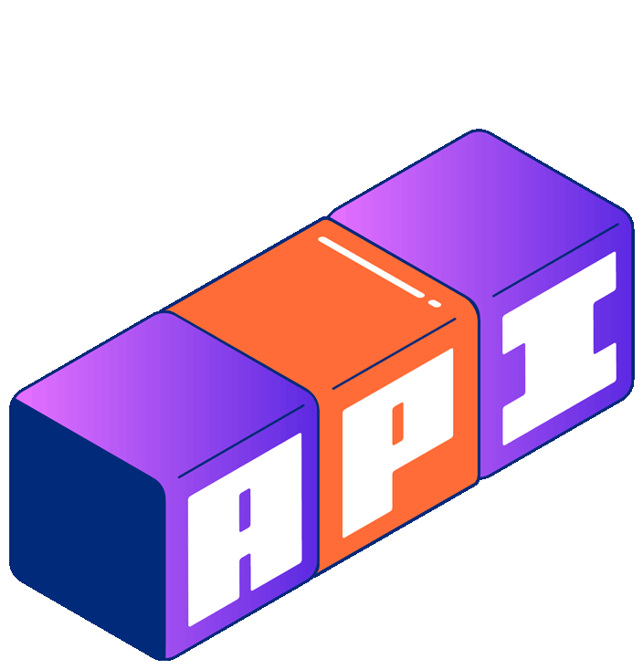

You can’t do AI without quality APIs:
MCP edition
Sterling Chin
Senior Developer Advocate
Notes:
Hey everyone! I'm Sterling, Senior Developer Advocate at Postman.
Let's kick off with one of my favorite tech comics.
FUCK YOU ORI!!!!!!!!!!!!!!

Slide 2

Notes:
"There are 14 competing standards? We need to develop one universal standard that covers everyone's use cases! And now there are 15 competing standards."
This comic dropped way back in 2011, and in the 14 years since then the standards problem hasn't gone away. Now we’ve got another standard with MCP. Although, I’d argue that MCP is really the universal adapter that will help us connect our existing APIs to AI.
Now with MCP, you can’t do AI without quality APIs.

Slide 3

The USB-C of AI Integration
Understanding
MCP
Notes:
Let's start with what MCP actually is. The Model Context Protocol is an open framework that standardizes how AI models interact with external tools and data sources.

Slide 4
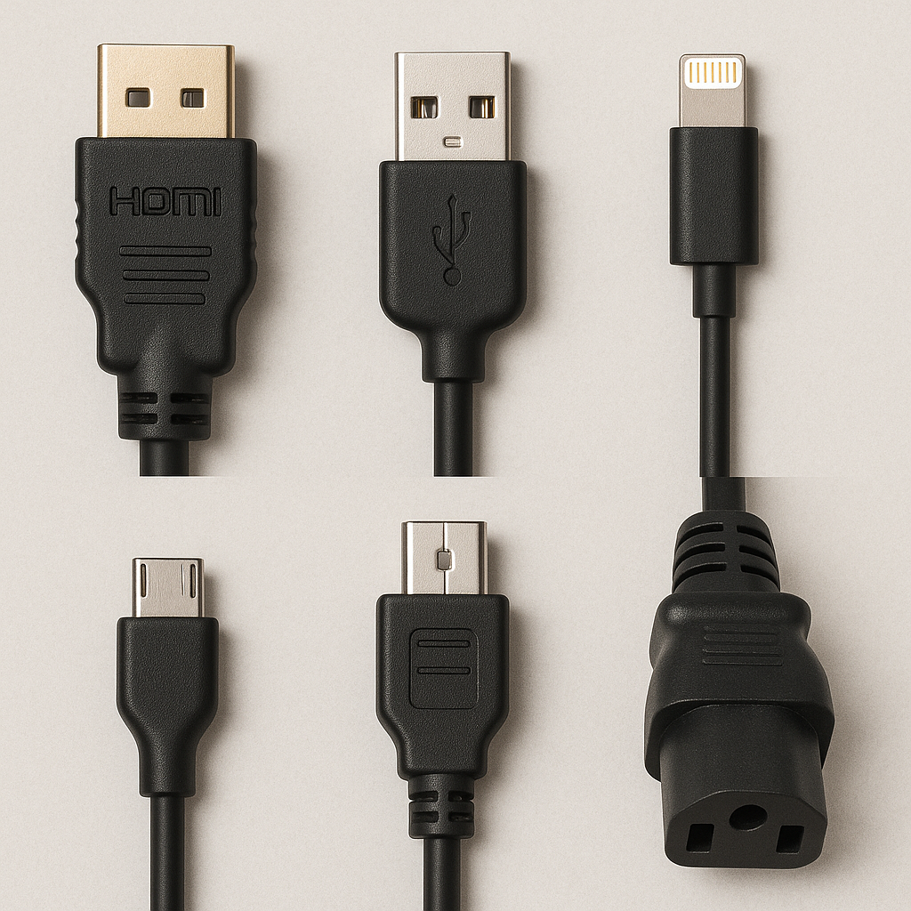
The USB-C of AI Integration
Notes:
Think of MCP as the USB-C of the AI world. Before USB-C, you needed different cables for different connections - HDMI for displays, USB-A for data, lighting adaptors for apple products, and various power adapters. Similarly, before MCP, developers had to build custom connections for each AI model and each service they wanted to integrate with - a time-consuming process that created vendor lock-in.

Slide 5
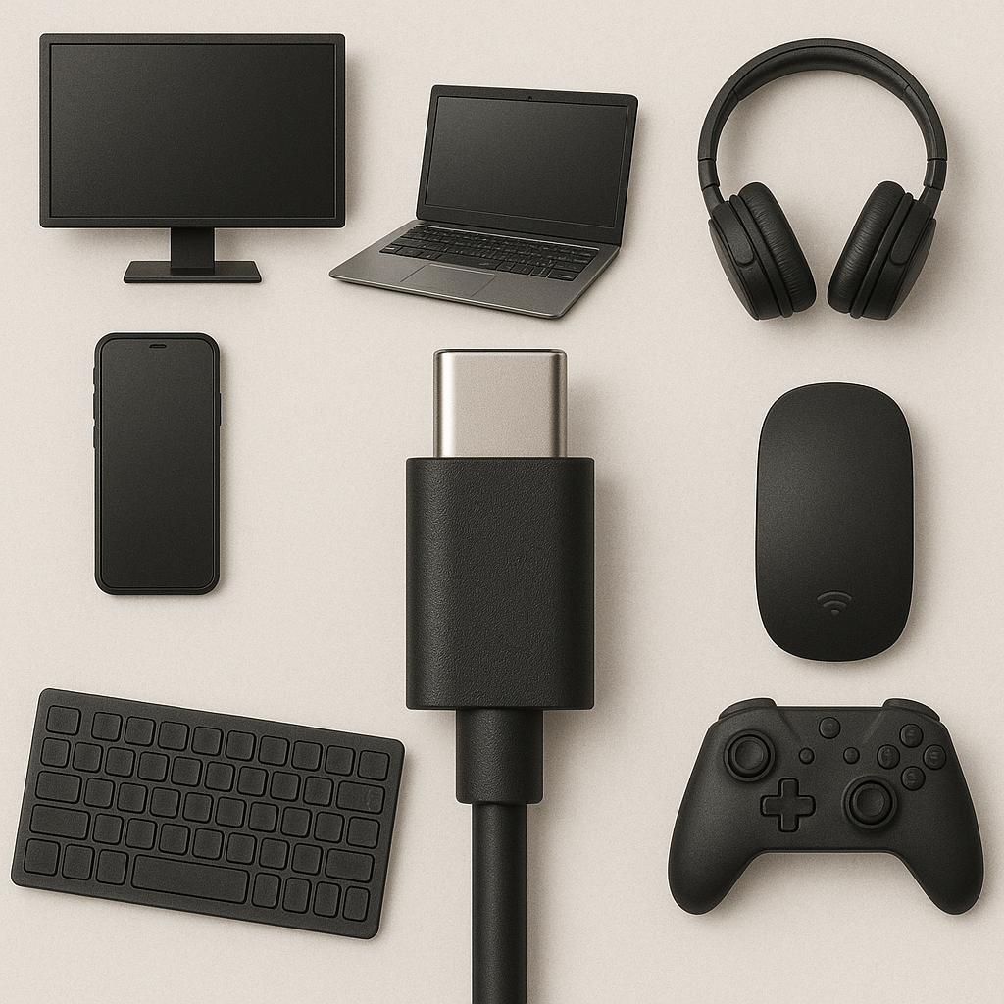
The USB-C of AI Integration
Notes:
Just as USB-C lets you connect countless devices with a single standard, MCP creates a universal adapter between AI models and the digital world. Build a connection once, use it with any compatible model.

Slide 6
The USB-C of AI Integration
3 types of capabilities
Resources
Tools
Prompts
Notes:
MCP servers provide three types of capabilities, each serving a distinct purpose:
Resources: These are data that AI models can read. Think of documents, databases, or API responses. For example, instead of copying and pasting your quarterly sales report into Claude, you could simply say 'Read my Q1 sales report' and Claude would access it directly through MCP.

Slide 7
The USB-C of AI Integration
3 types of capabilities
Resources
Tools
Prompts
Notes:
Tools: These are actions that AI models can perform with your permission. They're essentially running code or making API calls on your behalf. For example, instead of Claude saying 'I can't check the weather,' it could say 'The current temperature in San Francisco is 70°F' because it used a weather tool to fetch real-time data.

Slide 8
The USB-C of AI Integration
3 types of capabilities
Resources
Tools
Prompts
Notes:
Prompts: These are specialized instruction templates that tell the LLM how to approach specific tasks. It's like having pre-configured personalities or expertise modes. For example, one prompt could instruct Claude to analyze code like a security expert, while another could have it respond like a kindergarten teacher explaining complex topics.

Slide 9
Fragmentation
The problem
MCP solves
Notes:
To understand why MCP matters, let's consider a real scenario.

Slide 10
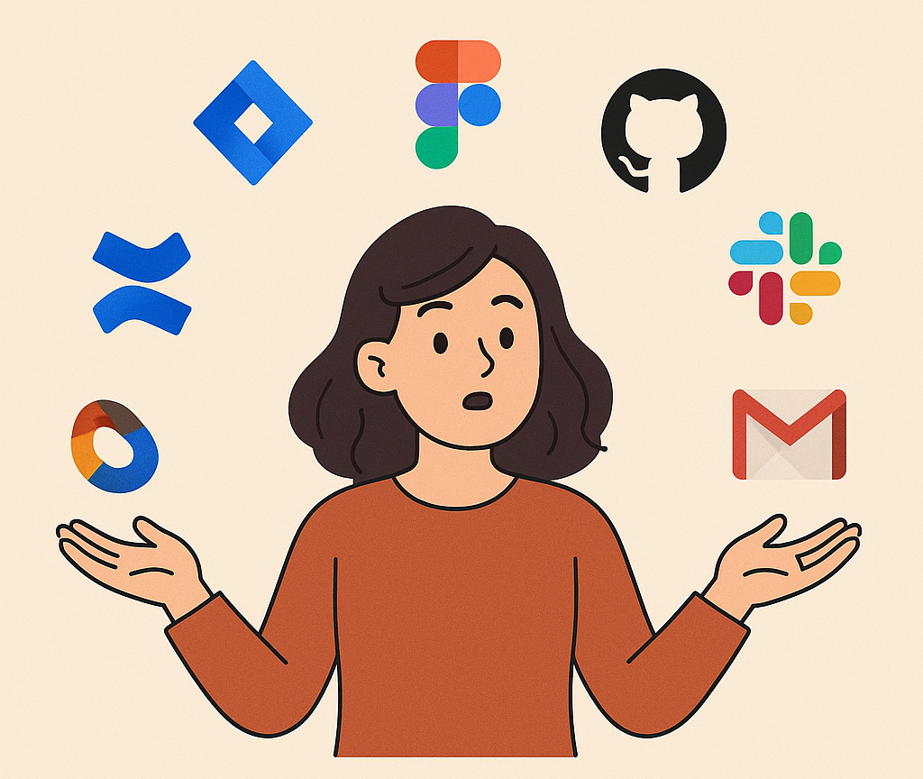
The problem MCP solves
Meet Lily: Product Manager
Notes:
Meet Lily, a product manager juggling projects across Jira, Figma, GitHub, Slack, Gmail, and Confluence.
Prior to MCP, if Lily wanted to use an AI to help manage these tools, she faced a problem: every model had its custom way of connecting to services. Each integration pulled her deeper into a single vendor's platform. When she needed to add a new tool like Gong for call transcripts, it meant building yet another bespoke connection.
This fragmentation created vendor lock-in. Switching to a better model meant rebuilding all your integrations from scratch - a massive cost that keeps teams stuck with suboptimal solutions.

Slide 11

The problem MCP solves
Meet Lily: Product Manager
Notes:
Today, Lily runs everything through her preferred AI model, connected to her work apps via an MCP server. Status reports draft themselves. Leadership updates are one prompt away. As new models emerge, she can swap them in without losing any of her integrations.
This is the world MCP enables - but there's a catch. The quality of your APIs directly impacts how effectively they can be used through MCP. And that's what we're going to explore today.

Slide 12




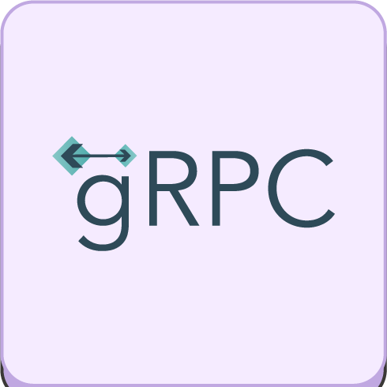
AI infrastructure
APIs in the MCP Era
Notes:
In the past three years, we've seen a massive shift where 74% of organizations now consider themselves API-first.

Slide 13
APIs in the MCP Era
The Shift
74% of orgs are API-first
APIs generate income for 62% of orgs
APIs drive 75% of revenue for 21% of orgs
Notes:
Consider these numbers in the context of our new AI-driven landscape:
APIs generate income for 62% of businesses
For 21% of companies, APIs drive over 75% of their revenue

Slide 14
APIs in the MCP Era
The Shift
74% of orgs are API-first
APIs generate income for 62% of orgs
APIs drive 75% of revenue for 21% of orgs
Notes:
Think about it: if one in five companies already depends on APIs for three-quarters of their income in the traditional economy, what happens when AI becomes the primary consumer of those APIs? The companies that make their APIs AI-ready will capture exponentially more value.

Slide 15
Through the lens of MCP
API protocols
Notes:
Ok, let’s talk about API protocols through the lens of MCP and AI. The key isn't abandoning what works, but understanding where each protocol excels in the AI context.

Slide 16
Through the lens of MCP
REST
The Universal Standard
Adoption - It powers the web
Simple, stateless, and scalable
Notes:
REST remains the universal standard, and for good reason:
Ubiquitous adoption means it's already in your stack
Well-understood by developers across your organization
MCP benefit: Consistent resource patterns make it easier for LLMs to understand your domain

Slide 17
Through the lens of MCP
REST
The Universal Standard
Adoption - It powers the web
Simple, stateless, and scalable
Notes:
Ideal for externally facing MCP servers where you need broad accessibility
The goal isn't to move away from REST, but to strengthen your existing REST APIs to work well with MCP without significant overhead.

Slide 18
Through the lens of MCP
GraphQL
“Exactly what you need”
Introspection
Flexible queries
Notes:
This is where things get truly exciting for AI integration:
Schema introspection is a game-changer for AI understanding
Self-documenting nature means AI can discover capabilities on its own
Flexible queries allow AI to request precisely what it needs

Slide 19
Through the lens of MCP
GraphQL
“Exactly what you need”
Introspection
Flexible queries
Notes:
GraphQL is arguably the strongest data protocol for MCP, working excellently for both internal and external facing servers. When an AI can explore your data structure on its own and formulate specific queries, it becomes dramatically more capable.

Slide 20
Through the lens of MCP
gRPC
“When milliseconds matter”
High Performance
Notes:
As enterprises connect AI into their internal systems, gRPC shines:
Blazing fast performance with minimal latency
Strong typing provides crystal-clear expectations about data formats
Efficient binary transmission for high-volume data exchange
Perfect for internal service-to-service communication

Slide 21
Through the lens of MCP
gRPC
“When milliseconds matter”
High Performance
Notes:
When your AI needs to process large datasets or perform computationally intensive operations across your internal systems, gRPC provides the performance and reliability required. This makes it ideal for building internal facing MCP servers that connect your AI to your core business systems.

Slide 22
Through the lens of MCP
WebSockets
Constant connection
Live data and notifications
Notes:
Any time you need real-time data flowing to your AI, WebSockets become essential:
Persistent connections eliminate polling overhead
Bidirectional communication allows interactive AI experiences
Event-driven architecture aligns with how AI agents process information
Valuable for both internal and external facing MCP servers

Slide 23
Through the lens of MCP
WebSockets
Constant connection
Live data and notifications
Notes:
Think of applications where AI needs to monitor and respond to events as they happen - trading platforms, monitoring systems, collaborative tools. WebSockets bridge the gap between human real-time interaction and AI capabilities.

Slide 24
Through the lens of MCP
Notes:
The bottom line? It's not about choosing a single protocol - it's about leveraging the right protocol for each integration point in your MCP ecosystem. REST for broad compatibility, GraphQL for flexible data exploration, gRPC for high-performance internal systems, and WebSockets for real-time interactions.

Slide 25

What Makes an AI-Ready API?
Notes:
The qualities that make an API successful with AI systems are different from what we've traditionally valued. In the MCP era, we need to rethink our fundamental API design principles.
So what makes an AI-ready API?

Slide 26
What makes an AI-ready API?
Machine-consumable metadata
Rich error semantics
Introspection capabilities
Consistent naming patterns
Notes:
They are:
Machine-consumable metadata
Rich error semantics
Introspection capabilities
Consistent name patterns

Slide 27
Machine-Consumable Metadata
Notes:
Humans and AI process information fundamentally differently. When a human developer reads documentation like this:
"This endpoint accepts a user ID and returns user preferences"
They fill in the gaps with contextual knowledge. They might think, "Oh, this must be a GET request that takes a UUID and probably returns a JSON object with preference key-value pairs."

Slide 28
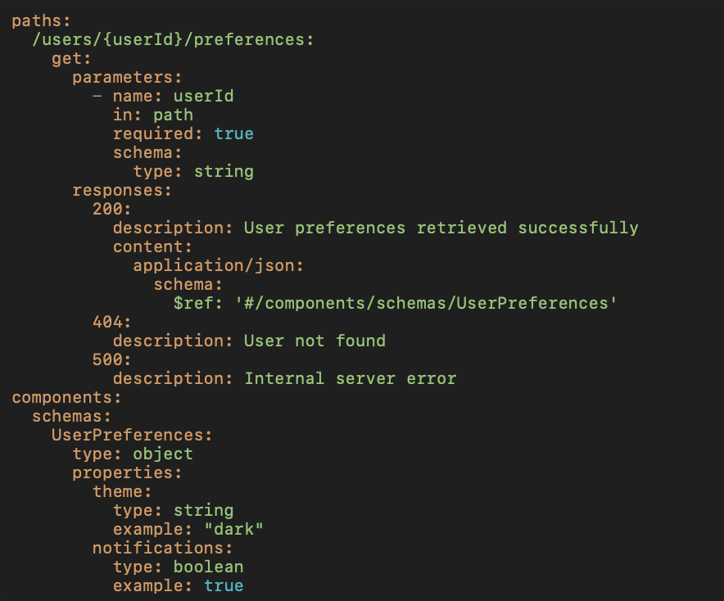
Machine-Consumable Metadata
Notes:
But an AI has none of this implicit context. It doesn't "know" that user IDs are typically UUIDs or that preferences are usually returned as a JSON object. Without explicit information, it's essentially guessing.
Here's what AI-ready metadata looks like:

Slide 29
Machine-Consumable Metadata
Notes:
The difference? The AI-ready version provides explicit semantic meaning through operationIds, detailed descriptions, parameter types, and schema references. It leaves nothing to interpretation or prior knowledge.
This is why API specs are so critical for MCP integration - they provide the explicit context that AI systems need to work effectively.
When you expose this through MCP, it empowers the AI to make intelligent decisions about when and how to use your API.

Slide 30
2. Rich Error Semantics
Notes:
The way we handle errors needs to change dramatically for AI-ready APIs.
Consider this typical error response:
When a human developer sees this, they bring years of troubleshooting experience to bear. They might check if the user ID exists, if they have permission to access the resource, or if they formatted the request correctly. They draw on implicit knowledge about common failure patterns.
An AI system has none of this troubleshooting intuition. It can't "just know" that "something went wrong" might mean the user ID is in the wrong format or that the resource doesn't exist.

Slide 31
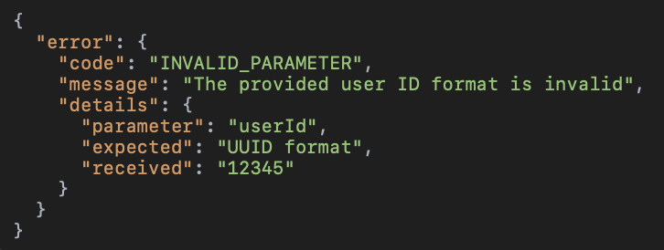
2. Rich Error Semantics
Notes:
Here's what an AI-ready error response looks like:
The AI-ready version not only explains exactly what went wrong, but provides explicit guidance on how to fix it. That "remediation" field is particularly valuable for AI systems - it essentially tells the AI, "Here's how you can solve this problem."
In an MCP context, this level of explicit error handling can be the difference between an AI agent that gets stuck and one that can recover and complete its task.

Slide 32
3. Introspection Capabilities
Complete schema definitions
All available operations
Input/output examples
Relationship hints between resources
Notes:
AI systems excel when they can discover your API's capabilities dynamically. This is why protocols with introspection (like GraphQL) have unique advantages in the MCP world.
For REST APIs, this means comprehensive OpenAPI specifications that include:
Complete schema definitions
All available operations
Input/output examples
Relationship hints between resources
When an AI can explore your API structure on its own, it can build much more sophisticated integrations without human intervention.

Slide 33
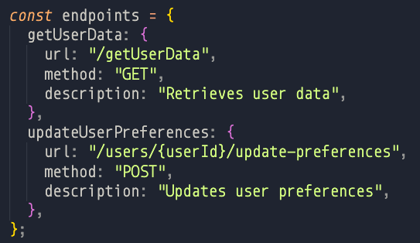
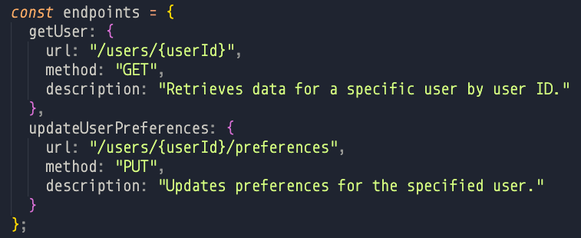
4. Consistent Naming and Patterns
Example 1 Example 2
Notes:
AI systems are much better than humans at detecting and exploiting patterns. Look at these two endpoint styles:

Slide 34
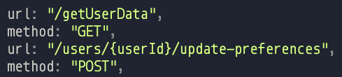
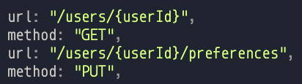
4. Consistent Naming and Patterns
Example 1 Example 2
Bad Good
Notes:
The second version follows consistent REST conventions, making it possible for AI to predict how your API works across endpoints it hasn't seen before. This significantly reduces the need for explicit instructions when using your API through MCP.
When you combine these AI-ready attributes with MCP, you create a powerful infrastructure that enables AI systems to work effectively with your services. This isn't just about accommodating AI - it's about unlocking its full potential.

Slide 35
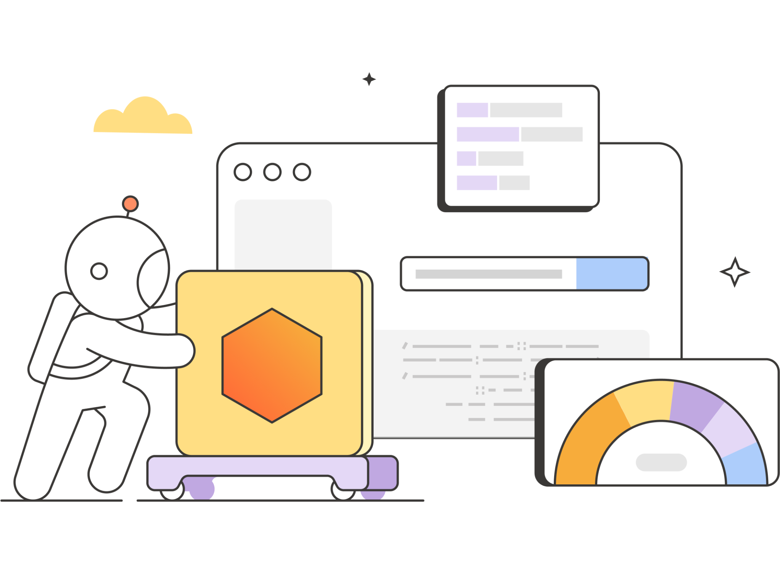
Preparing Your APIs for AI & MCP
Notes:
So what does this mean for your API strategy? The emergence of MCP demands a fundamental rethinking of how we approach APIs in an AI-first world.

Slide 36
Preparing your APIs for AI integration is about elevating your API game altogether
Notes:
Many organizations have invested heavily in REST APIs optimized for human developers. But the question we need to ask now is: "Are these the right protocols for an AI-first world?"
Let's be honest about the tradeoffs:

Slide 37
Preparing your APIs for AI integration is about elevating your API game altogether
Notes:
REST is ubiquitous and well-understood, but can become verbose when AI needs to make multiple calls to assemble complex data
GraphQL shines when AI needs to explore and formulate its own queries, with introspection being a game-changer for autonomous AI agents
gRPC offers performance advantages that become critical when AI makes thousands of API calls at machine speed
WebSockets enable the real-time interaction that many AI applications require

Slide 38
Preparing your APIs for AI integration is about elevating your API game altogether
Notes:
The protocols that historically made sense for human developers might not be optimal when your primary consumer is an AI model. This doesn't mean abandoning your existing infrastructure, but it does mean strategically evolving it with AI consumption patterns in mind.

Slide 39

From theory to practice
Next Steps for your MCP Journey
Notes:
So where do you go from here? As we've explored today, the emergence of MCP represents a fundamental shift in how APIs and AI interact. Let me share three actionable steps that can help you prepare for this new reality:

Slide 40
From theory to practice
Start Small:
Single high-value API
Notes:
Start with a Single High-Value API
Don't try to transform everything at once. Select one business-critical API and make it truly AI-ready:

Slide 41
From theory to practice
Start Small:
Single high-value API
Notes:
Enhance its metadata to be explicitly machine-readable
Implement rich error responses with remediation advice
Add introspection link capabilities through OpenAPI specs, or through the graph.
Ensure consistent naming and patterns
This single proof-of-concept can demonstrate value faster than a broad but shallow approach.

Slide 42
From theory to practice
Discoverable:
API visibility
Notes:
If you're building APIs for external consumption, visibility is critical. Publishing your verified APIs on the Postman Public Network isn't just about documentation—it's about connecting with the developers and AI integrators who can derive the most value from your services.

Slide 43
From theory to practice
Discoverable:
API visibility
Notes:
When you verify your APIs on public networks like Postman's, you're signaling to customers and partners that your services are ready for the AI revolution. In the MCP era, discoverability becomes a competitive advantage.

Slide 44
From theory to practice
AI-First:
Building for AI consumption
Notes:
Build for AI Consumption First
This may be the most significant mindset shift: start designing APIs with AI consumers as the primary use case. When you architect an API that works seamlessly with AI through MCP, you'll find it works even better for human developers.

Slide 45
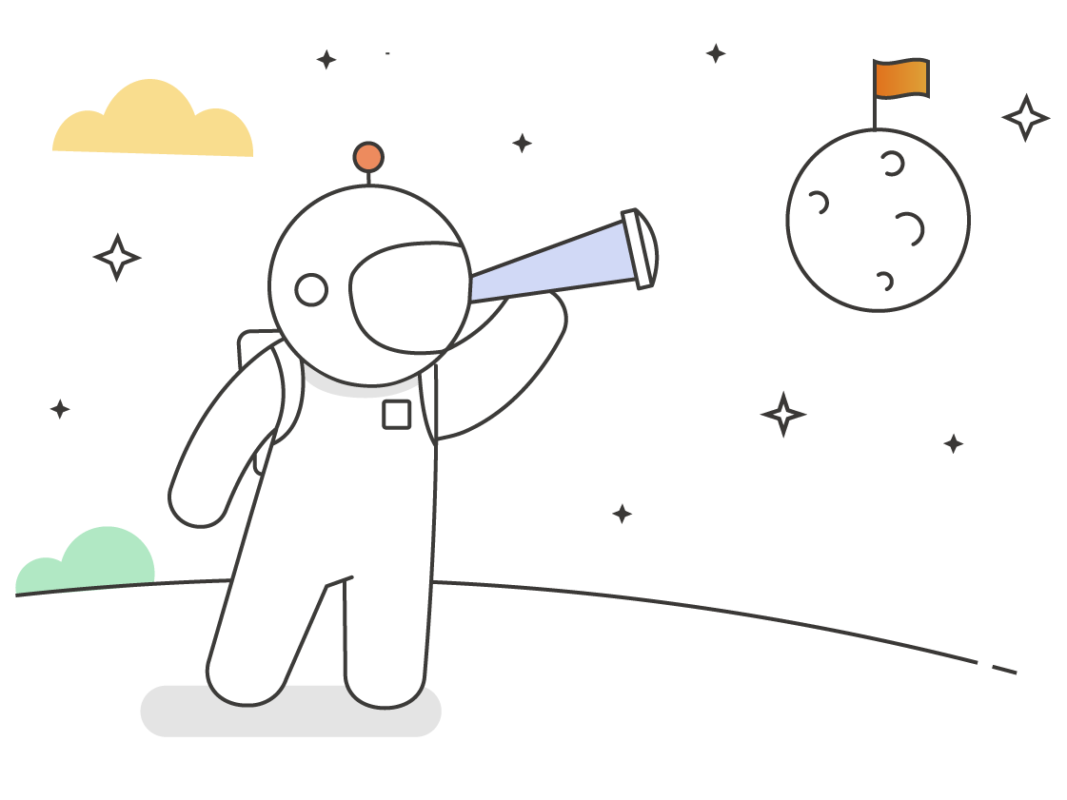
Where we go from here
Notes:
For decades, APIs have been viewed primarily as technical implementations—the plumbing that connects different systems. But in the MCP era, they've become something far more strategic: they are the primary interface through which AI understands and interacts with your business capabilities.
Think about what this means:
The companies that will dominate the AI-powered future won't necessarily be those with the most sophisticated models or the most data. They'll be the ones whose capabilities are most accessible to AI through quality, well-designed APIs exposed via MCP.

Slide 46
Where we go from here
Notes:
For many organizations, this is a fundamental shift in their mindset. We're no longer building APIs just for human developers—we're building them for AI systems that operate at machine speed, with machine logic, and at machine scale. The quality requirements are different, and the stakes are higher.
This is why I say with absolute confidence: You can't do AI without quality APIs. Full stop.

Slide 47
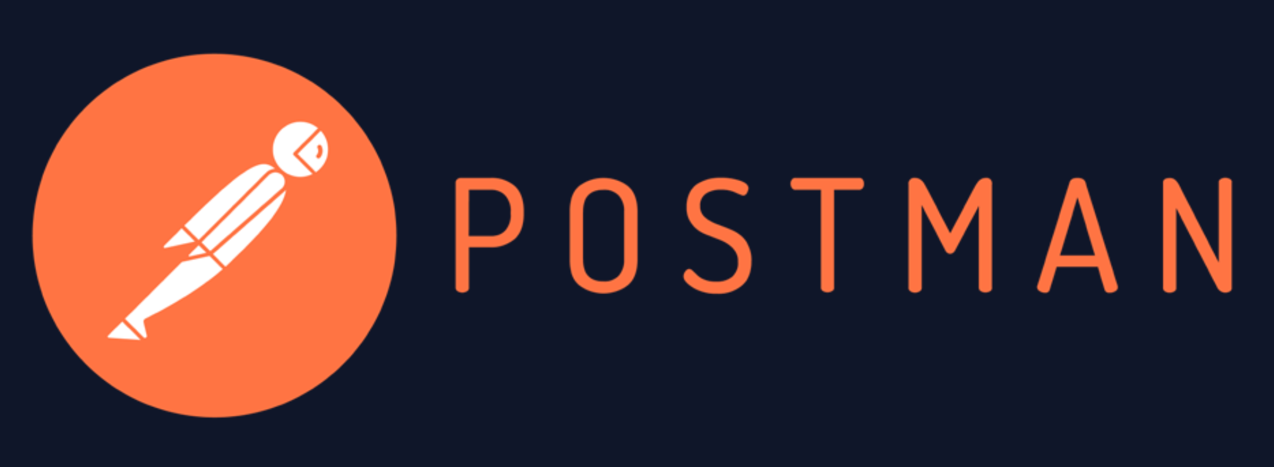
Free Food!
Booth #407
Free pastries
Swag!
Demo
Chat with our team

Slide 48




Thank you
https://www.linkedin.com/in/sterlingchin/
@SilverJaw82
@sterlingchin.bsky.social
https://sterlingchin.com
Notes:
Thank you!

